Slide 1








Showcasing you!
Notes:
<insert pictures from the event here instead>

Slide 2


Microsoft Build: Student Developer Drop-In Day
28th May 10AM - 6PM
In Person Event
Salman Chishti
Chris Noring
Microsoft Azure & Windows Insider MVP
Microsoft Senior Cloud Advocate Lead
aka.ms/student-hub

Slide 3
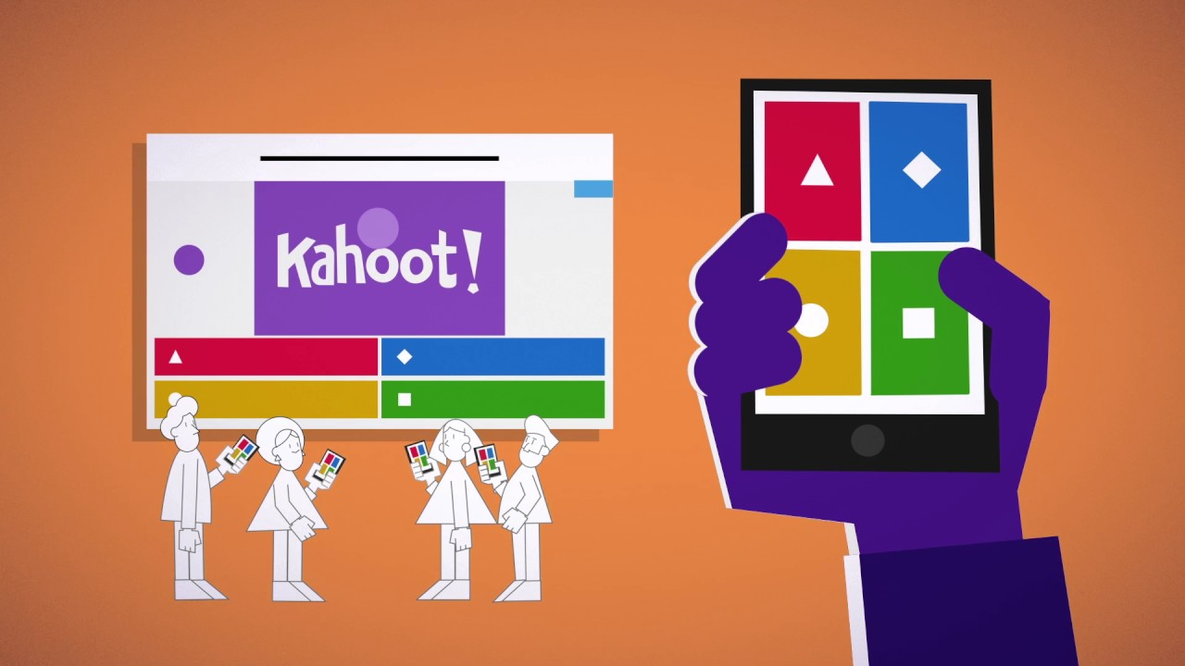
Potential time for another quiz

Slide 4
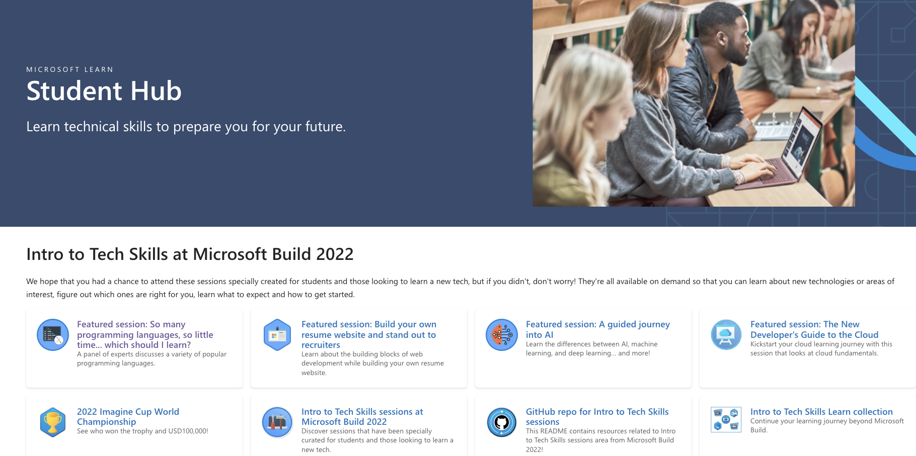
Student hub landing page
Your number one place to:
Skill up, with our free resources
Grow a network and increase chances to get hired by Microsoft, via student ambassador program
Get set up with Azure for students, student pack and more
aka.ms/student-hub

Slide 5
Next steps
Resources from today!
Microsoft-Build-Student-Developer-Drop-in-day Resources
Student Hub
https://aka.ms/learnstudent
Cloud Skills Challenge https://aka.ms/StudentDeveloperDayChallenge
Azure Skills Navigator
https://github.com/MicrosoftDocs/devrampup
aka.ms/student-hub

